Slide 1
Veteran Suicide by Race/Ethnicity: Assessments Among All Veterans and Veterans Receiving VHA Health Services, 2001-2014
John McCarthy, PhD, MPH¹, Brady Stephens, MS²,
Talya Peltzman, MPH¹, Sybil Morley, MPH²
¹Serious Mental Illness Treatment Resource and Evaluation Center
Office of Mental Health and Suicide Prevention
²Center of Excellence for Suicide Prevention
Department of Veterans Affairs
August 2017
Notes:
http://www.mentalhealth.va.gov/docs/2016suicidedatareport.pdf

Slide 2
Overview
Background
Suicide Trends Among US Adults
VA Suicide Analytics
Knowledge Gap
Objectives
Methods
Findings
Veterans with Recent VHA Encounters
All Veteran Suicide Decedents
Discussion

Slide 3
Trends

Slide 4
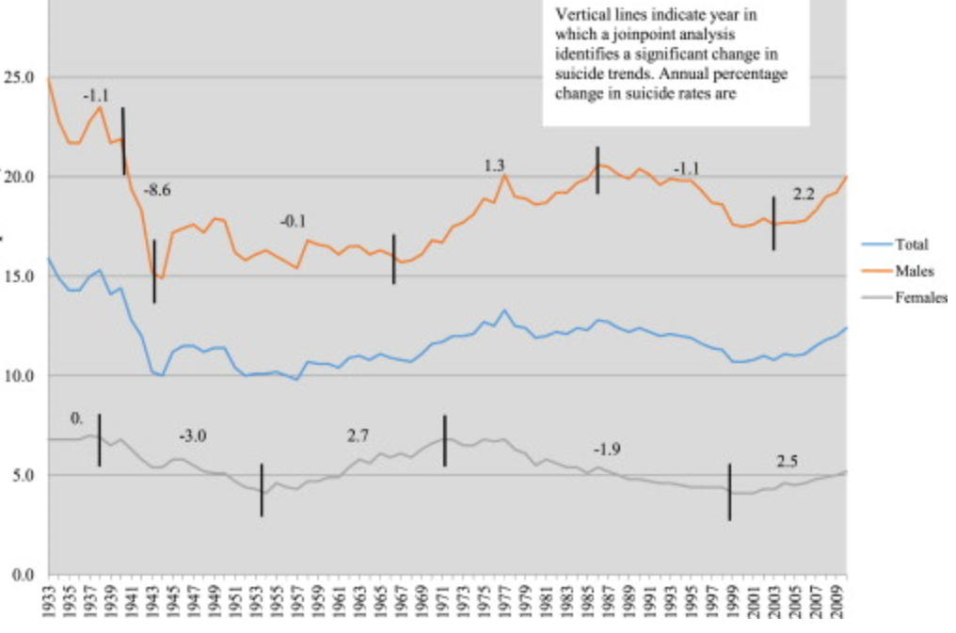
US Suicide Deaths per 100,000, by Sex, 1933-2010 (Phllips, 2014)
Notes:
Suicide is a national health policy concern. The epidemiology of suicide has changed over the past half century. In the United States, after relative stability from the 1930s to early 1950s, followed by increases through the early 1980s, rates fell through the late 1990s, and have since increased. The rise has been noted in the Baby Boomer cohort and has continued among subsequent cohorts (Phillips et al., 2014).

Slide 5
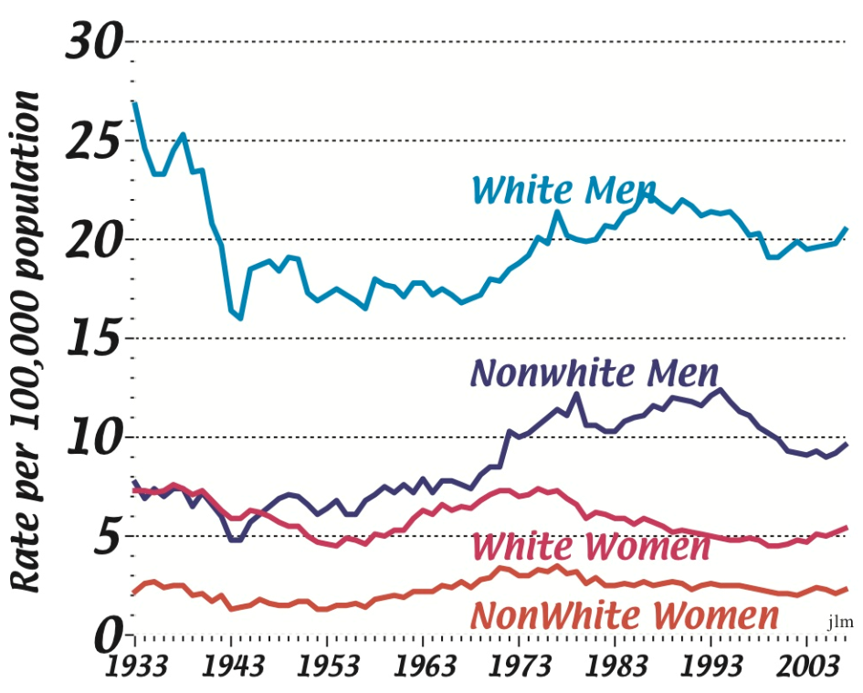
Source: U.S. National Center for Health Statistics http://mypage.iu.edu/~jmcintos/SuicideStats.html
Notes:
Data prepared by Dr. John McIntosh for the American Association of Suicidology summarize trends in rates from 1933 to 2007 among White and Nonwhite men and women. Rates were substantially higher among men than among women and, among men and women they were highest among those recorded as White.
U.S. National Center for Health Statistics (http://mypage.iu.edu/~jmcintos/SuicideStats.html)
Prepared for the American Association of Suicidology
by John L. McIntosh, Ph.D., Professor of Psychology, Indiana University South Bend
Referenced by Phillips et al., 2014.

Slide 6
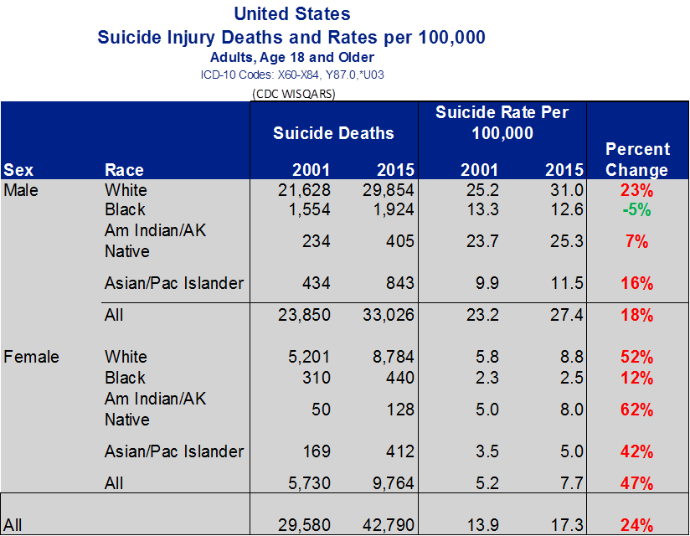
Notes:
Between 2001 and 2015, the suicide rate among US adults rose 24%, from 13.9 to 17.3 per 100,000. Rates among men rose 18%, from 23.2 to 27.4 per 100,000 and among women the rates rose 47% from 5.2 to 7.7 per 100,000 (CDC WISQARS, 2017).
Among men in 2015, suicide rates ranged from 31.0 for White men, 25.3 for American Indian/Alaskan Native men, 12.6 for Black men and 11.5 for Asian/Pacific Island men. Rates decreased among Black men by 5.2% and increased for all other groups.
Among women in 2015, rates were 8.8 among White women, 8.0 among American Indian / Alaska Native women, 5.0 among Asian / Pacific Islanders, and 2.5 among Black women. Rates increased among women for each ethnic group, ranging from an increase of 61.8% among American Indian / Alaska Natives to 11.9% among Black women. These rates and trends document substantial variation in suicide rates by sex and by ethnic group.
Also, and this is not presented on the slide, among White men rates increased most substantially among those age 50-54, 55-59, and 60-64 (49.7%, 43.0% and 43.4%, respectively).

Slide 7
Need for Public Health Approach
Medical examiner assessments in 13 states indicate differences among suicide decedents by race/ethnicity (Karch et al., 2006)
Hispanics less likely to have received a mental health diagnosis or treatment
Non-Hispanic Whites more likely to have received antidepressants and opiates
Non-Hispanic Blacks had lower blood alcohol content, greater likelihood diagnosis of schizophrenia
Need for population-based monitoring and outreach strategies
Suicide prevention requires both:
Health system treatment approaches
e.g., for those with identified mental health treatment needs
Comprehensive public health approaches (David-Ferdon et al., 2016.)
Notes:
Analyses of suicide decedents in 13 states, using the CDC’s National Violent Death Reporting System, indicate that per medical examiner assessments there are differences among suicide decedents by race/ethnicity (Karch et al., 2006)
Hispanics less likely to have received a mental health diagnosis or treatment
Non-Hispanic Whites more likely to have received antidepressants and opiates
Non-Hispanic Blacks had lower blood alcohol content, greater likelihood diagnosis of schizophrenia

Slide 8
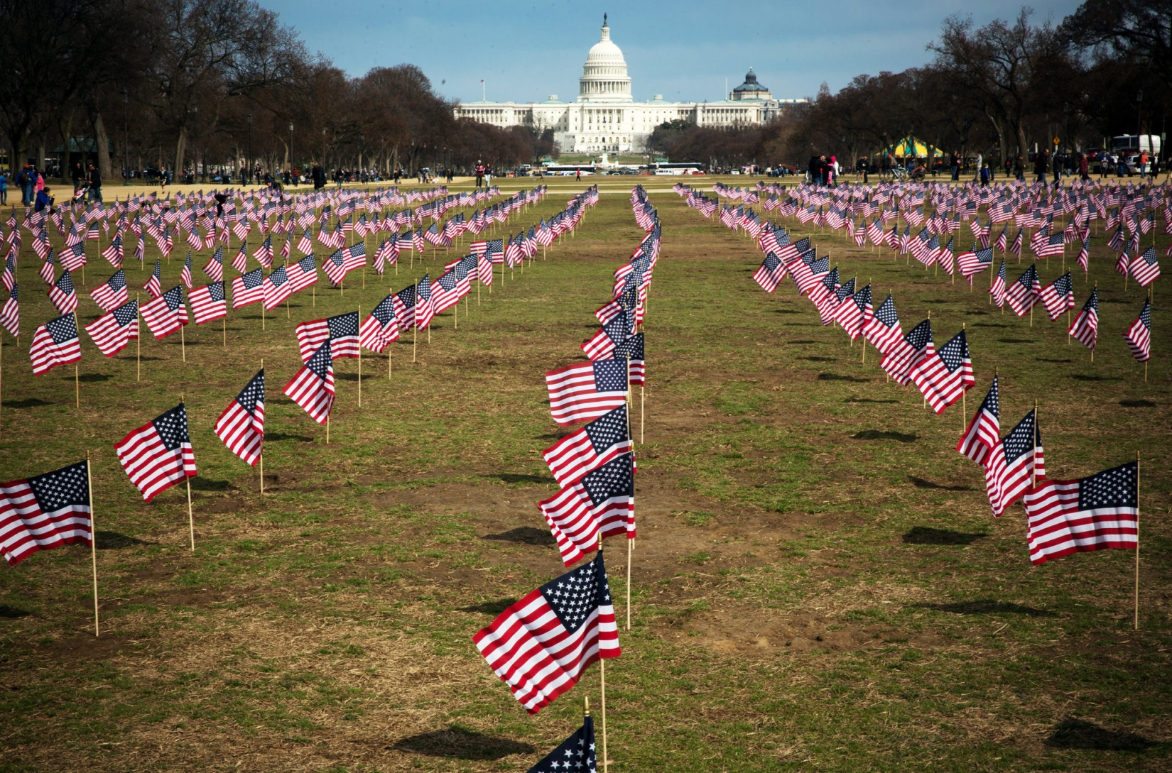
Notes:
Death by suicide is a human tragedy that affects us all. Suicide prevention is a national concern, and particularly so with regard to Veteran suicide. The social contract applies powerfully for Veterans, who have served and sacrificed for their fellow Americans. Veteran suicide prevention is a key priority for the Department of Veterans Affairs (VA).

Slide 9
VA Suicide Analytics

Slide 10
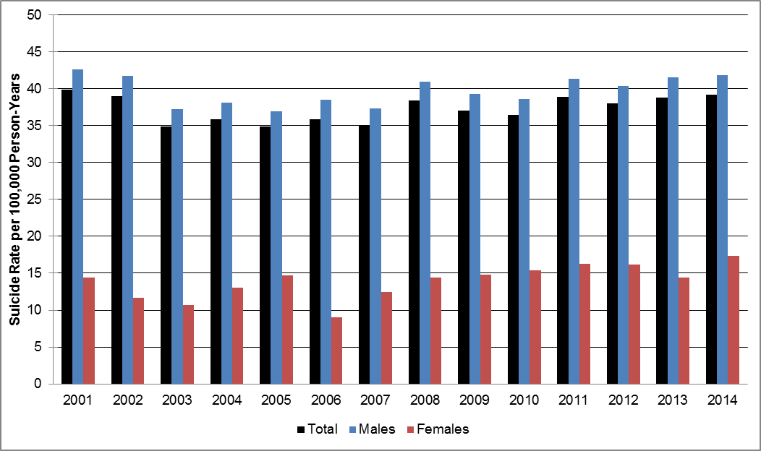
Suicide Rates Among VHA Users by Sex and Year
Notes:
In 2005, the VA health system, operated by the Veterans Health Administration (VHA), began unprecedented comprehensive monitoring of suicide among VHA patients. In recent years, this work has grown to encompass joint searches with the Department of Defense of the CDC’s National Death Index (NDI). The NDI is the gold standard of US mortality databases. It includes death certificate information collected by state vital statistics offices, and enables assessment of mortality status and cause of death. Based on massive data searches, many analyses have been completed, reports written, risk factors identified, and new tools have been developed to inform and assist with Veteran suicide prevention. However, analyses to date have often failed to include an important demographic measure, Veteran race/ethnicity, and consequently the analyses to date have failed to illuminate a potentially helpful dimension for understanding suicide risks among Veterans.

Slide 11
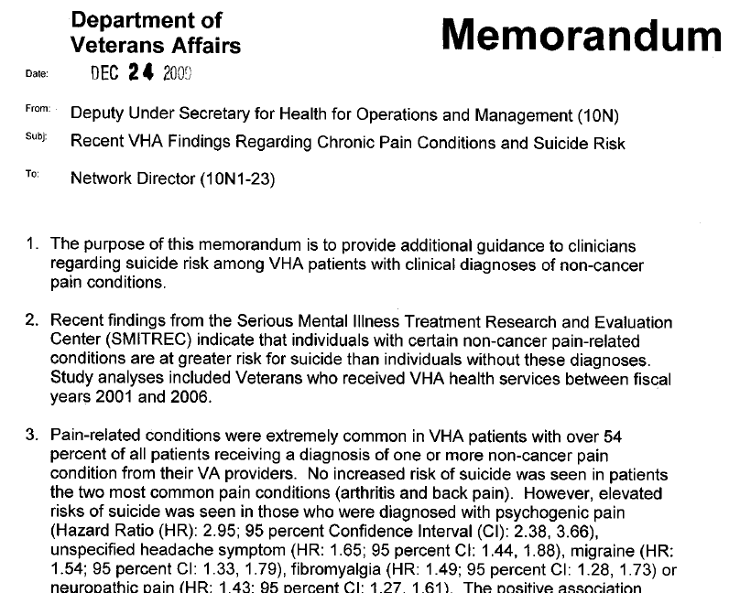
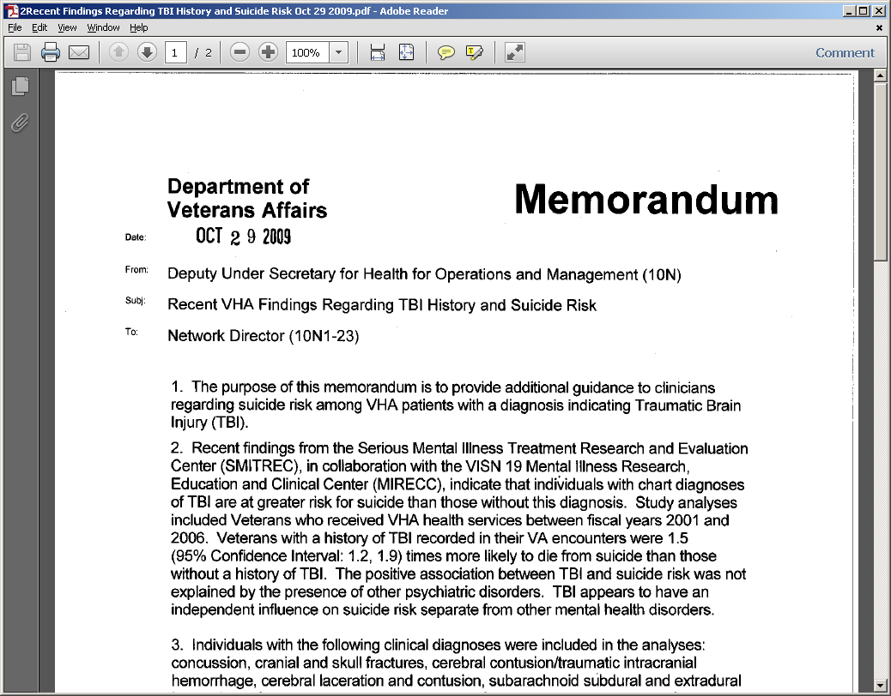
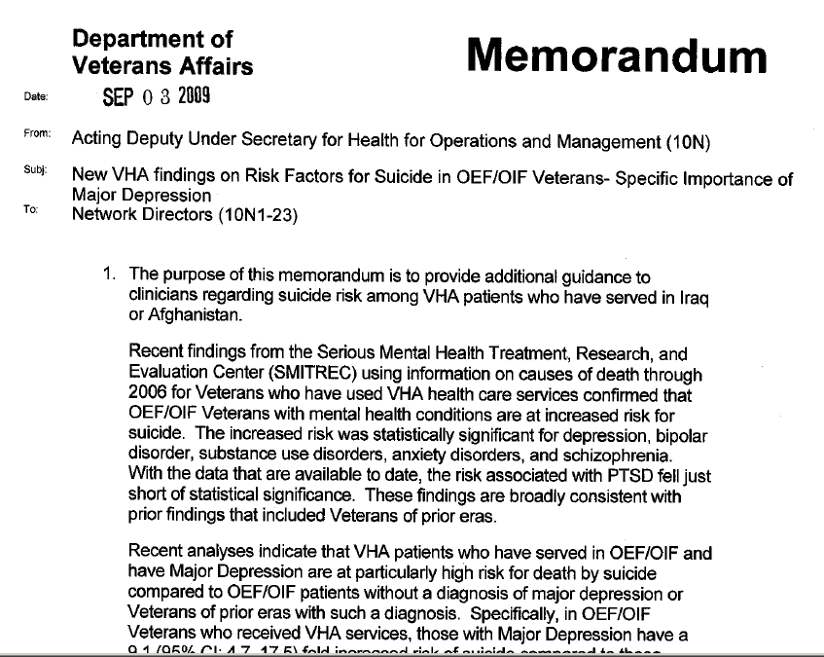
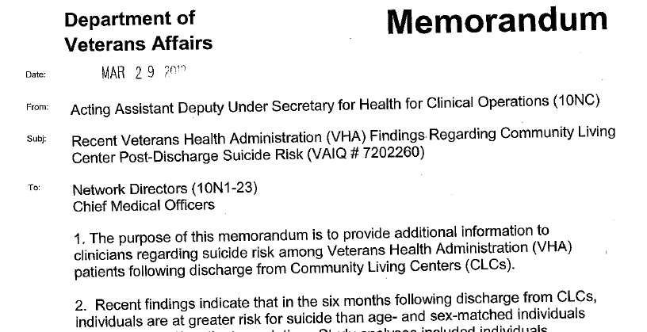

Slide 12
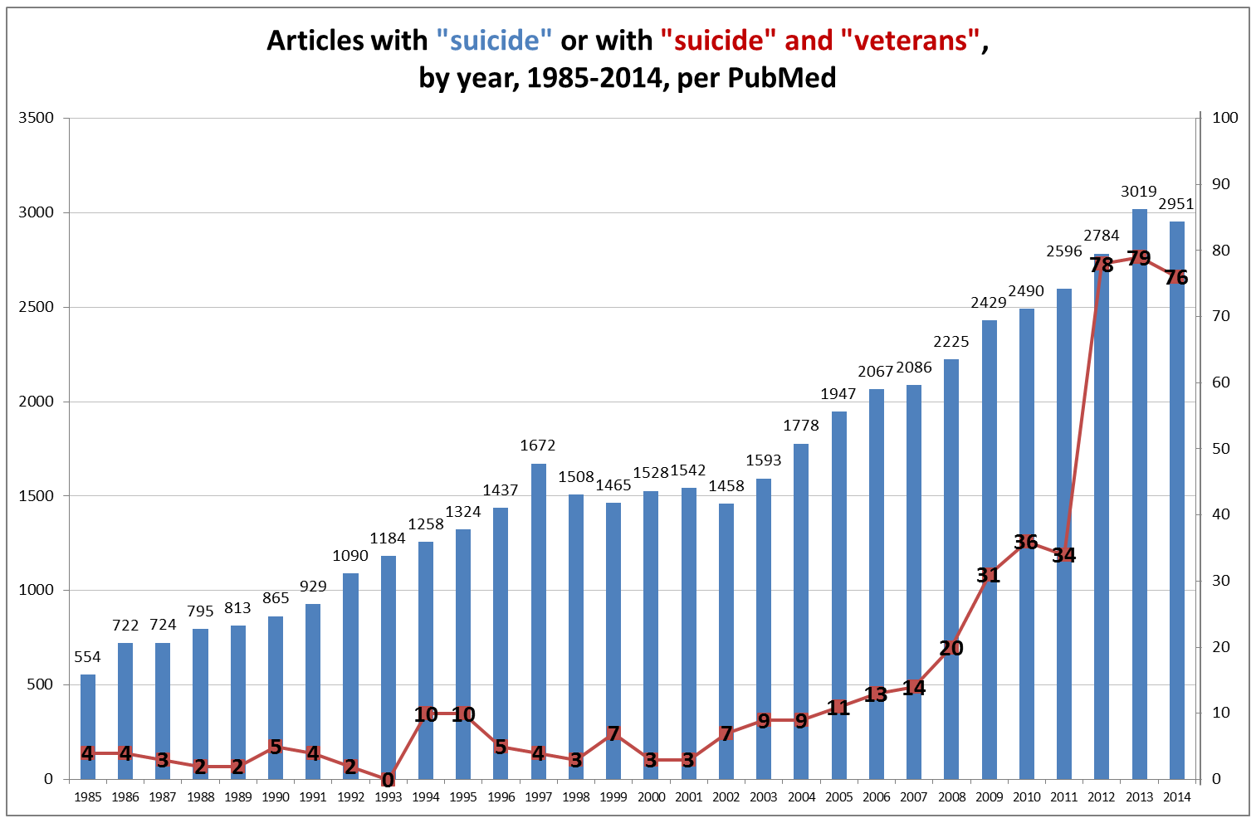
From 0.7% to 2.6% of English Language PubMed articles including “suicide”, 1985 -2014.
(suicide [tw]) and (veterans [tw]) and (2014 [dp]) and (english [LA])

Slide 13
Knowledge Gap
Notes:
In VA health system assessments of suicide rates, it has not been possible to include adjustment for race/ethnicity, as these data were not consistently included in the VA administrative records (McCarthy et al., 2009; Ilgen et al., 2010; Blow et al., 2012; McCarthy et al., 2012.) Per a review of published studies, the reported prevalence of missing or unknown race information for VHA patients has been as high as 48% (Stroupe et al., 2010). Among VA patients who died of suicide 2009 and matched controls, assessment of the VA Corporate Data Warehouse resulted in missing race information for 19% of subjects (Dobscha et al., 2014). Among 5.5 million recipients of VA outpatient care in 2012, race/ethnicity was missing or unknown for 11.8% (Backus et al., 2014.)

Slide 14
Knowledge Gap: Veteran Suicide Mortality by Race/Ethnicity
Among Veterans Receiving Care in the VA health system
VA health system indicators regarding race/ethnicity
Shift in 2003-2004 in data collection, measures, from staff observation to Veteran self-report
Non-random missingness: Those with missing information more likely to be female, younger
Studies regarding VA patients had high levels of missing information
Stroupe et al. (2010): Among 114 published studies, documented high levels of missing or unknown for race/ethnicity -- as high as 48%
Among VA patients who died of suicide 2009 and matched controls, missing race information was reported for 19% of subjects (Dobscha et al., 2014).
Among 5.5 million recipients of VA outpatient care in 2012, race/ethnicity was missing or unknown for 11.8% (Backus et al., 2014.)
VA suicide monitoring lacked information on rates by race/ethnicity
(McCarthy et al., 2009; Ilgen et al., 2010; Blow et al., 2012; VA, Suicide Data Report, 8/3/16)
Among All Veterans
Prior to August of 2016, VA lacked comprehensive data regarding Veteran suicide
VA and the Department of Defense have conducted joint National Death Index searches
Provides new information on Veteran suicide for the overall Veteran population
Notes:
In VA health system assessments of suicide rates, it has not been possible to include adjustment for race/ethnicity, as these data were not consistently included in the VA administrative records (McCarthy et al., 2009; Ilgen et al., 2010; Blow et al., 2012; McCarthy et al., 2012.) Per a review of published studies, the reported prevalence of missing or unknown race information for VHA patients has been as high as 48% (Stroupe et al., 2010). Among VA patients who died of suicide 2009 and matched controls, assessment of the VA Corporate Data Warehouse resulted in missing race information for 19% of subjects (Dobscha et al., 2014). Among 5.5 million recipients of VA outpatient care in 2012, race/ethnicity was missing or unknown for 11.8% (Backus et al., 2014.)

Slide 15
Objectives
Suicide mortality among Veterans in VA health system care, by race/ethnicity
Race/ethnicity patterns among all Veteran suicide decedents, by race/ethnicity
Notes:
In VA health system assessments of suicide rates, it has not been possible to include adjustment for race/ethnicity, as these data were not consistently included in the VA administrative records (McCarthy et al., 2009; Ilgen et al., 2010; Blow et al., 2012; McCarthy et al., 2012.) Per a review of published studies, the reported prevalence of missing or unknown race information for VHA patients has been as high as 48% (Stroupe et al., 2010). Among VA patients who died of suicide 2009 and matched controls, assessment of the VA Corporate Data Warehouse resulted in missing race information for 19% of subjects (Dobscha et al., 2014). Among 5.5 million recipients of VA outpatient care in 2012, race/ethnicity was missing or unknown for 11.8% (Backus et al., 2014.)

Slide 16
Initial Assessment: Distribution of Race/Ethnicity Indicators, Recent VHA User Cohorts, by Year
Index Year | American Indian/ Native Am.(%) | Asian (%) | Black (%) | Hispanic- Black (%) | Hispanic- White (%) | Unknown (%) | White (%)
2001 | 0.21 | 0.33 | 8.88 | 0.26 | 3.03 | 47.64 | 39.66
2002 | 0.20 | 0.32 | 8.41 | 0.25 | 2.87 | 49.33 | 38.63
2003 | 0.17 | 0.28 | 7.48 | 0.22 | 2.56 | 55.31 | 33.99
2004 | 0.15 | 0.24 | 6.67 | 0.2 | 2.31 | 60.48 | 29.96
2005 | 0.13 | 0.22 | 6.15 | 0.18 | 2.16 | 63.92 | 27.23
2006 | 0.41 | 0.92 | 11.22 | 0.17 | 2.02 | 30.08 | 55.19
2007 | 0.44 | 1.01 | 11.68 | 0.16 | 1.91 | 27.34 | 57.44
2008 | 0.48 | 1.08 | 12.14 | 0.15 | 1.81 | 25.58 | 58.75
2009 | 0.52 | 1.15 | 12.54 | 0.14 | 1.68 | 24.03 | 59.94
2010 | 0.56 | 1.21 | 12.85 | 0.13 | 1.55 | 22.78 | 60.92
2011 | 0.61 | 1.29 | 13.26 | 0.12 | 1.44 | 21.01 | 62.26
2012 | 0.66 | 1.36 | 13.69 | 0.11 | 1.29 | 19.70 | 63.19
2013 | 0.72 | 1.46 | 14.17 | 0.11 | 1.21 | 18.15 | 64.18
2014 | 0.79 | 1.60 | 14.88 | 0.10 | 1.14 | 15.58 | 65.91

Slide 17
Methods
Annual cohorts, Veterans with recent VA encounters
Race/ethnicity determined using VA best practices and, for all Veterans analyses, from U.S. Veterans Eligibility Trends and Statistics (USVETS) database
Suicide mortality per VA/DoD Suicide Data Repository
Examined distribution of suicide deaths by race/ethnicity
-- Veteran VHA users, overall and by sex
-- All Veterans
Notes:
VIREC technical reports and studies by VA researchers suggest that various measures can be taken to improve missing race/ethnicity information in core VHA datasets (comparable coding frameworks)

Slide 18
Improved Assessment of Race/Ethnicity
Applied VA best practices:
Searched all records within a year and multiple years
Prioritized:
standard vs. historical
self-reports vs. observations
When >1 self-identified value was listed: ‘Other/Multiple Races’
Used CMS_Race from Vital Status File when not otherwise available
Notes:
VIREC technical reports and studies by VA researchers suggest that various measures can be taken to improve missing race/ethnicity information in core VHA datasets

Slide 19
Initial Assessment: Distribution of Race/Ethnicity Indicators, Recent VHA User Cohorts, by Year
Index Year | American Indian/ Native Am.(%) | Asian (%) | Black (%) | Hispanic- Black (%) | Hispanic- White (%) | Two or More (%) | Unknown (%) | White (%)
2001 | 0.51 | 1.16 | 14.04 | 0.26 | 3.68 | 1.14 | 7.17 | 72.04
2002 | 0.49 | 1.17 | 13.46 | 0.25 | 3.54 | 1.15 | 6.72 | 73.22
2003 | 0.49 | 1.20 | 13.25 | 0.24 | 3.46 | 1.17 | 6.73 | 73.47
2004 | 0.49 | 1.25 | 13.32 | 0.24 | 3.50 | 1.21 | 6.71 | 73.29
2005 | 0.51 | 1.31 | 13.49 | 0.24 | 3.59 | 1.23 | 6.34 | 73.29
2006 | 0.52 | 1.37 | 13.65 | 0.24 | 3.68 | 1.24 | 6.01 | 73.29
2007 | 0.54 | 1.41 | 13.81 | 0.24 | 3.78 | 1.25 | 6.09 | 72.90
2008 | 0.56 | 1.44 | 14.05 | 0.24 | 3.85 | 1.26 | 6.36 | 72.23
2009 | 0.58 | 1.47 | 14.28 | 0.24 | 3.91 | 1.28 | 6.49 | 71.76
2010 | 0.60 | 1.48 | 14.46 | 0.24 | 3.96 | 1.29 | 6.49 | 71.47
2011 | 0.62 | 1.51 | 14.70 | 0.25 | 4.04 | 1.31 | 6.42 | 71.16
2012 | 0.65 | 1.53 | 14.96 | 0.25 | 4.12 | 1.33 | 6.55 | 70.60
2013 | 0.67 | 1.58 | 15.24 | 0.26 | 4.21 | 1.36 | 6.78 | 69.90
2014 | 0.69 | 1.63 | 15.49 | 0.27 | 4.31 | 1.41 | 6.99 | 69.20

Slide 20
Findings: Veterans with Recent VA Encounters

Slide 21
Distribution of Suicides (2001 - 2014) among Recent VHA Veteran Users, by Race/Ethnicity

Slide 22
Distribution of Suicides (2001 - 2014) among Recent VHA Male Veteran Users, by Race/Ethnicity

Slide 23
Distribution of Suicides (2001 - 2014) among Recent VHA Female Veteran Users, by Race/Ethnicity

Slide 24
Suicide Rate per 100,000, US Adults, 2001-2015, by Race/Ethnicity

Slide 25
Suicide Rate Per 100,000 Person Years, Recent Veteran VHA Users, 2001 - 2014, by Race/Ethnicity*

Slide 26
Suicide Rate per 100,000, US Men, 2001-2015, by Race/Ethnicity

Slide 27
Suicide Rate Per 100,000 Person Years, Recent Male Veteran VHA Users, 2001 - 2014, by Race/Ethnicity*

Slide 28
Suicide Rate per 100,000, US Women, 2001-2015, by Race/Ethnicity

Slide 29
Suicide Rate Per 100,000 Person Years, Recent Female Veteran VHA Users, 2001 - 2014, by Race/Ethnicity*

Slide 30
Findings: Distribution of Suicides Among All Veterans

Slide 31
Distribution of Suicides (2001 - 2014) by Race/Ethnicity among All Veterans
Notes:
The combined race/ethnicity was defined such that any Veteran with Hispanic ethnicity was indicated as Hispanic. Recent VHA Utilizing Veterans are defined as those who used VHA services in the calendar year of or prior to their death. Recent VHA User status and race for recent VHA users was defined by SMITREC; race/ethnicity information for non-recent VHA User Veterans obtained from USVETS.

Slide 32
Distribution of Suicides (2001 - 2014) by Race/Ethnicity among Recent VHA User Veterans

Slide 33
Distribution of Suicides (2001 - 2014) by Race/Ethnicity among Veterans not in VA Care
Notes:
The combined race/ethnicity was defined such that any Veteran with Hispanic ethnicity was indicated as Hispanic. Recent VHA Utilizing Veterans are defined as those who used VHA services in the calendar year of or prior to their death. Recent VHA User status and race for recent VHA users was defined by SMITREC; race/ethnicity information for non-recent VHA User Veterans obtained from USVETS.

Slide 34
Suicide Deaths, Among All Veterans, by Sex and Minority Status, 2001 - 2014
Notes:
Non-Minorities are White non-Hispanic and all other race categories are included in the minority classification. This excludes those with missing/unknown minority status. The percent with missing or unknown minority status ranged from 7.2% to 21.5% per year and averaged 13.6% per year. Race/ethnicity information obtained from USVETS.

Slide 35
Distribution of Suicides (2001 - 2014) by Race/Ethnicity among All Veterans

Slide 36
Distribution of Suicides (2001 - 2014) by Race/Ethnicity among All Male Veterans

Slide 37
Distribution of Suicides (2001 - 2014) by Race/Ethnicity among All Female Veterans
Notes:
The combined race/ethnicity was defined such that any Veteran with Hispanic ethnicity was indicated as Hispanic. Race/ethnicity information obtained from USVETS.

Slide 38
Conclusions
Comprehensive reporting of Veteran suicide by race/ethnicity
Findings can inform ongoing suicide prevention activities
Enhanced reporting and analyses
Further work
Understand individual, social, and community influences
Risk and resilience
Assess potential misclassification (Rockett et al., 2010)
Non-Hispanic Whites more likely to leave suicide note than non-Hispanic Blacks or Hispanics

Slide 39
Thank you! Any questions?
John.McCarthy2@va.gov
734-277-8737

